Slide 1

TnT: A File System Synchronizer
Justin Holmgren
Zach Kabelac
Pritish Kamath
Deepak Vasisht

Slide 2



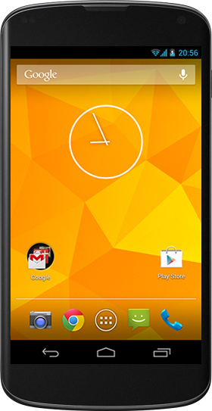
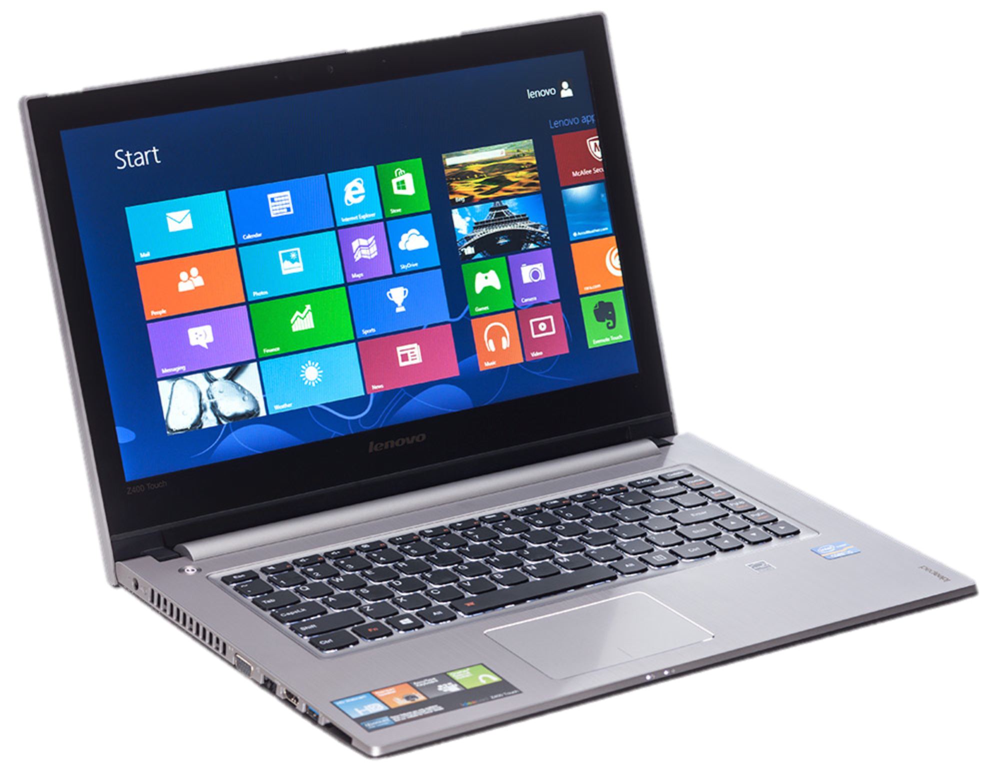
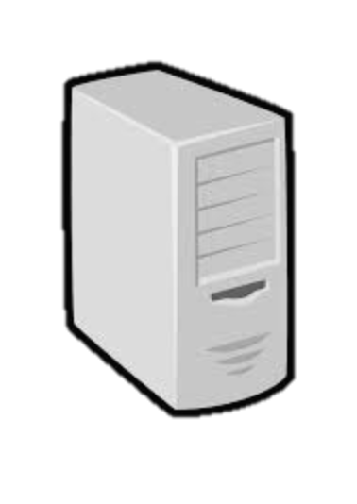
Distributed File Synchronizer

Slide 3
Problem Statement
Desirable Properties
No restriction on synchronization patterns
No false conflicts
No metadata for deleted files
Network usage proportional to changed files
Partial synchronizations within the file tree

Slide 4
Design of Tra
Vector Time Pairs
Sync and Version Vectors
Creation Times
Start Sync
Do you have any changes that I don’t know about?
No
Do Nothing
Yes
Yes
Do I have any changes that you don’t know about?
Update
No
Conflict

Slide 5
System Design
File Watcher
Raises interrupts on File System changes
Failure Recovery
Update Metadata and move files to tmp directory
Dump Metadata to disk
Apply necessary changes
Again dump Metadata to disk
In case of crash, browse tmp and file system

Slide 6
TnT Evaluation
Correctness
100K random system updates across 5 machines
Metadata Overhead

